Slide 1
Module 4:
Large-Scale Machine Learning (Supervised)

Slide 2
Agenda
Introduction
Introduction to Large-Scale Supervised Machine Learning
Naïve Bayesian
Baye’s Theorem
Examples
SVM
Concept of Support Vector Machines, Advantages & Disadvantages
Examples
k-Nearest Neighbors (kNN)
What is kNN?
Examples
PySpark, ML Library
Decision Trees
Classification Problem
DT, Hunts Algorithm, Examples
Examples of DT, NB, SVM, and kNN using PySpark
Exercises

Slide 3
Introduction
Machine Learning Algorithms for Big Data Analytics
Big Data analysis requires scalable distributed computations.
Spark scalable MLib (machine-learning library) consists of the widely used ML algorithms and utility functions for large datasets.
MLib includes the algorithms for optimization-primitives, regression, collaborative filtering, dimensionality reduction, cluster analysis, classification and recommender.
Uses of Machine Learning (ML) and Artificial Neural Networks (ANN) are in analytics, predictive modeling and decisions.
The analytics methods include data mining, pattern mining, clusters analysis and detection of anomalies.
In AI, 'machine learning' and 'deep learning' provide powerful tools for advanced analytics and predictions.

Slide 4

What is Artificial Intelligence?
Artificial intelligence (AI) is a machine’s ability to perform the cognitive functions we usually associate with human minds.
Artificial intelligence is the simulation of human intelligence processes by machines, especially computer systems.
Applications: expert systems, natural language processing, speech recognition, and machine vision.

Slide 5
Machine Learning (ML)
Machine Learning is a subset of artificial intelligence.
It allows the machines to learn and make predictions/recommendations based on its experience i.e. data.
E.g. Netflix’s recommendation engine. Amazon, Flipkart Apps.
ML techniques use unsupervised, semi-supervised or supervised learning.
Supervised learning uses a known dataset (called training dataset).
Learning enables creation of a model program for evaluating outcomes.

Slide 6
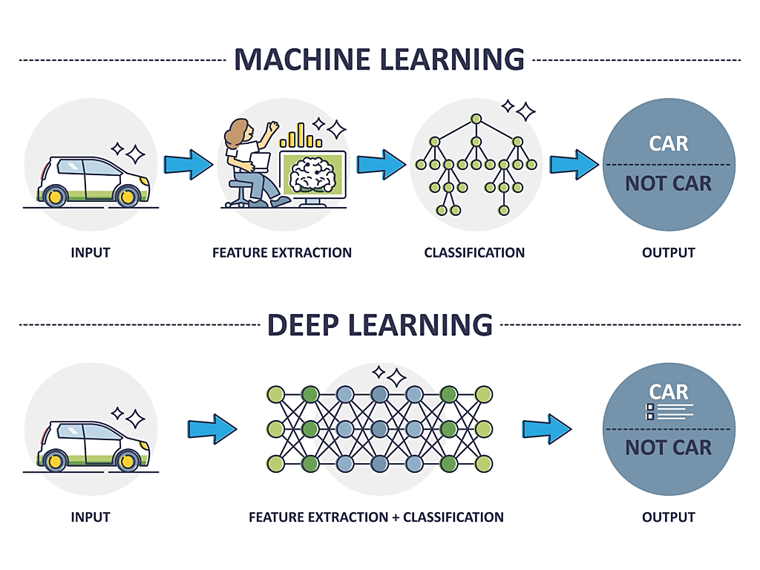
Deep Learning
Deep learning is a subset of machine learning, which is essentially a neural network with three or more layers.
It teaches computers to process data in a way that is inspired by the human brain.
Deep learning is a key technology behind driverless cars, enabling them to recognize a stop sign, or to distinguish a pedestrian from a lamppost.

Slide 7
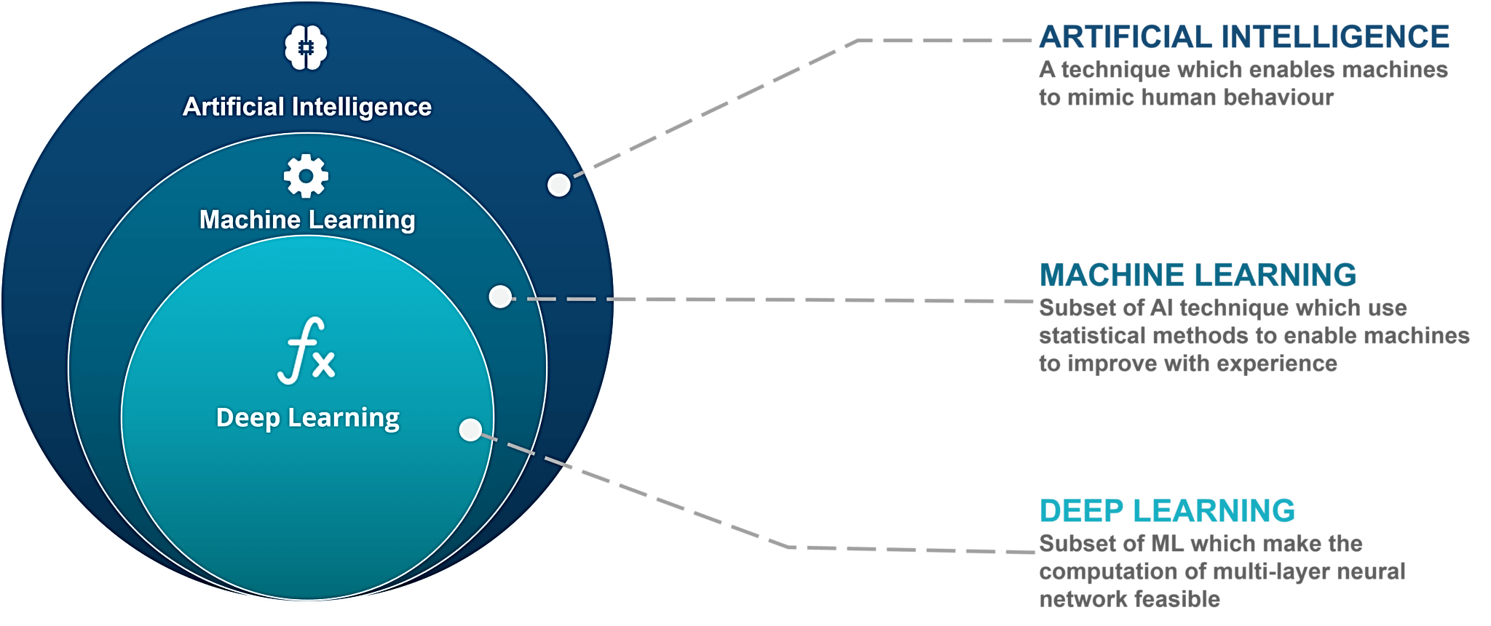
Comparison of AI-ML-DL

Slide 8
Introduction to DT
Decision trees are a simple way to guide one’s path to a decision.
Decision trees are hierarchically branched structures that help one come to a decision based on asking certain questions in a particular sequence.
The decision may be a simple binary one, whether to approve a loan or not.
Or it may be a complex multivalued decision, as to what may be the diagnosis for a particular sickness.

Slide 9
Case Study
Predicting Heart Attacks Using Decision Trees
A study was done at UC San Diego concerning heart disease patient data.
The patients were diagnosed with a heart attack from chest pain, diagnosed by EKG, high enzyme levels in their heart muscles, and so on.
Predict which of these patients was at risk of dying from a second heart attack within the next 30 days.
The prediction would determine the treatment plan, such as whether to keep the patient in intensive care or not.
Features: 100 ⇒ demographics, medical history, and lab data.
Using that data and the CART algorithm, a decision tree was constructed.

Slide 10
Outcome
If blood pressure (BP) was low (≤90), the chance of another heart attack is 70%
If the age was low (≤62), then the patient’s survival was almost guaranteed (98%).
Accuracy = 86.5%

Slide 11
Classification - A Two-Step Process
Model construction: describing a set of predetermined classes
  Each tuple/sample is assumed to belong to a predefined class, as determined by the class label attribute
  The set of tuples used for model construction is training set
  The model is represented as classification rules, decision trees, or mathematical formulae
Model usage: for classifying future or unknown objects
  Estimate accuracy of the model:-
  The known label of test sample is compared with the classified result from the model
  Accuracy rate is the percentage of test set samples that are correctly classified by the model
  Test set is independent of training set, otherwise over-fitting will occur
  If the accuracy is acceptable, use the model to classify data tuples whose class labels are not known

Slide 12
Learning Phase: Model Construction
Classification
Algorithms
Training
Data
Classifier
(Model)
IF age = ‘young’
THEN loan_dec = ‘risky’
IF income = ‘high’
THEN loan_dec = ‘safe’ …..

Slide 13
Classification
To test the classifier accuracy
Classification
rules
Testing
Data
Unseen Data
(Jeff, middle_aged, low)
RISKY

Slide 14
Example of a Decision Tree
categorical
categorical
continuous
class
Splitting Attributes
Refund
Yes
No
NO
MarSt
Single, Divorced
Married
TaxInc
NO
< 80K
> 80K
NO
YES
Training Data
Model: Decision Tree

Slide 15
Another Example of Decision Tree
categorical
categorical
continuous
class
MarSt
Single, Divorced
Married
NO
Refund
Yes
No
NO
TaxInc
< 80K
> 80K
NO
YES
There could be more than one tree that fits the same data!

Slide 16
Decision Tree Classification Task
Decision Tree

Slide 17
Apply Model to Test Data
Test Data
Start from the root of tree.
Refund
Yes
No
NO
MarSt
Single, Divorced
Married
TaxInc
NO
< 80K
> 80K
NO
YES

Slide 18
Apply Model to Test Data
Test Data
Refund
Yes
No
NO
MarSt
Single, Divorced
Married
TaxInc
NO
< 80K
> 80K
NO
YES

Slide 19
Apply Model to Test Data
Test Data
Refund
Yes
No
NO
MarSt
Single, Divorced
Married
TaxInc
NO
< 80K
> 80K
NO
YES

Slide 20
Apply Model to Test Data
Test Data
Refund
Yes
No
NO
MarSt
Single, Divorced
Married
TaxInc
NO
< 80K
> 80K
NO
YES

Slide 21
Apply Model to Test Data
Test Data
Refund
Yes
No
NO
MarSt
Single, Divorced
Married
TaxInc
NO
< 80K
> 80K
NO
YES

Slide 22
Apply Model to Test Data
Test Data
Refund
Yes
No
NO
MarSt
Single, Divorced
Married
Assign Cheat to “No”
TaxInc
NO
< 80K
> 80K
NO
YES

Slide 23
Decision Tree Classification Task
Decision Tree

Slide 24
Decision Tree Problem
Imagine a conversation between a doctor and a patient.
The doctor asks questions to determine the cause of the ailment.
The doctor would continue to ask questions, till he or she is able to arrive at a reasonable decision.
This is how experts in any field solve problems. They use decision trees or decision rules.
Human experts learn from past experiences or data points.
Similarly, a machine can be trained to learn from the past data points and extract some knowledge or rules from it.

Slide 25
DT Problem…
More training data is provided, the more accurate its knowledge
More variables the tree can choose from, the tree will come out better with higher accuracy

Slide 26
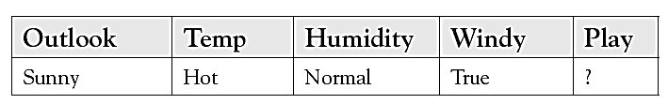
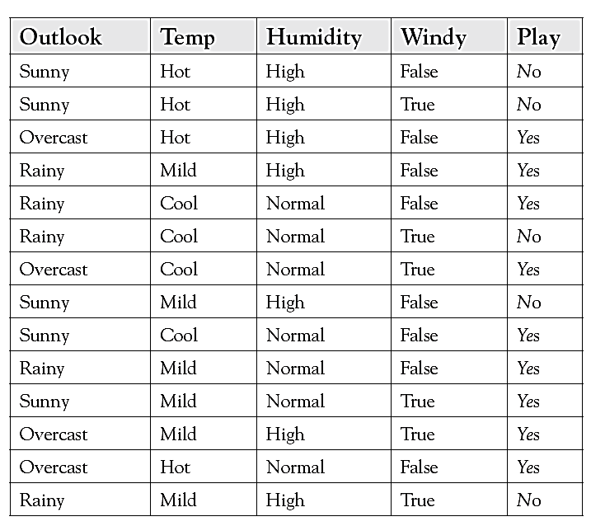
Example

Slide 27
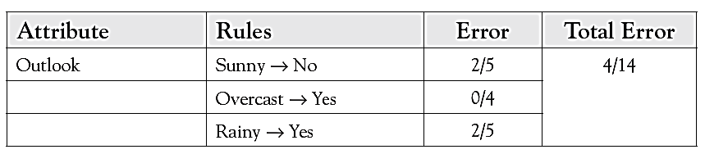
Decision Tree Construction
How should the root node of the tree be determined?
A criterion should be used by which one of these questions gives the most insight about the situation
Start with “Outlook”

Slide 28
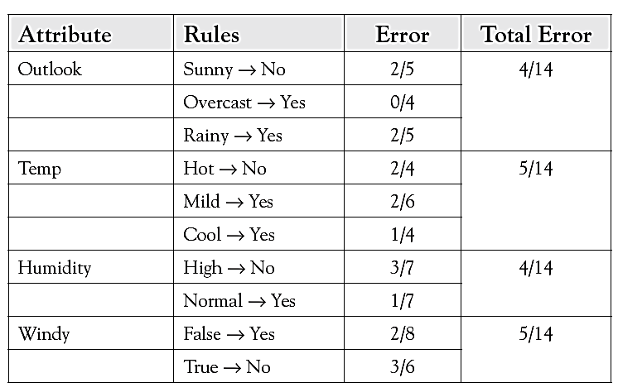
Other Variables

Slide 29
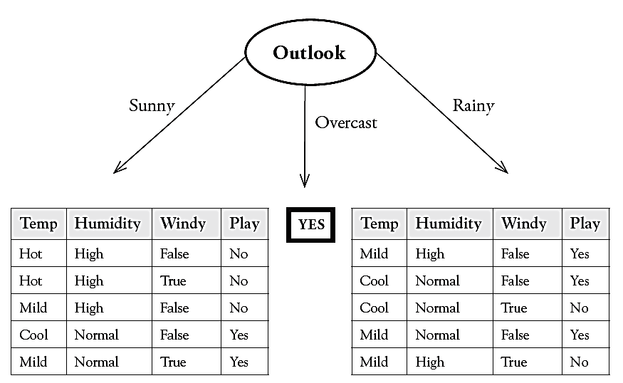
Tree

Slide 30
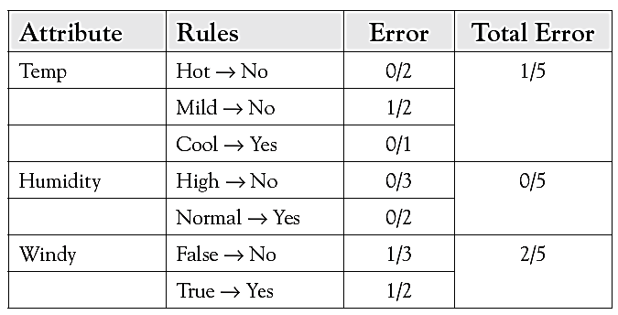
Determining the next nodes of the tree
For the sunny branch on the left, error values will be calculated for the three other variables: temp, humidity, and windy.

Slide 31
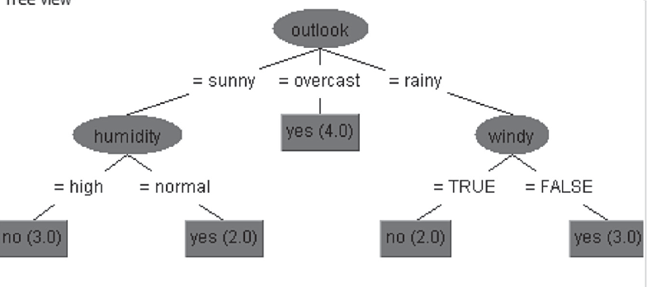
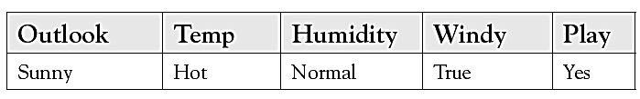
Final DT
Result

Slide 32
Example-2 (hair Length)
Sl. No. | Hair Length | Weight | Age | Class
1 | short | over | middle | M
2 | long | correct | middle | F
3 | short | low | child | M
4 | medium | low | child | F
5 | medium | low | child | F
6 | short | correct | old | M
7 | long | correct | old | F
8 | long | over | middle | M
9 | medium | over | old | M

Slide 33
Example-2 (Weight)
Sl. No. | Hair Length | Weight | Age | Class
1 | short | over | middle | M
2 | long | correct | middle | F
3 | short | low | child | M
4 | medium | low | child | F
5 | medium | low | child | F
6 | short | correct | old | M
7 | long | correct | old | F
8 | long | over | middle | M
9 | medium | over | old | M

Slide 34
Example-2 (Age)
Sl. No. | Hair Length | Weight | Age | Gender
1 | short | over | middle | M
2 | long | correct | middle | F
3 | short | low | child | M
4 | medium | low | child | F
5 | medium | low | child | F
6 | short | correct | old | M
7 | long | correct | old | F
8 | long | over | middle | M
9 | medium | over | old | M

Slide 35
DT
X = <long, over, middle>
Hair Length
short
medium
long
Weight
Weight
M
low
over
correct
over
F
M
F
M

Slide 36
Inferences
Accuracy = 100%
The decision tree algorithm selected the minimum number of variables that are needed to solve the problem
This tree is symmetric
It is possible to increase predictive accuracy by making more subtrees and making the tree longer
A perfectly fitting tree has the danger of overfitting the data, thus capturing all the random variations in the data
Decision trees are based strictly on observing patterns within the data, and do not rely on any underlying theory of the problem domain

Slide 37
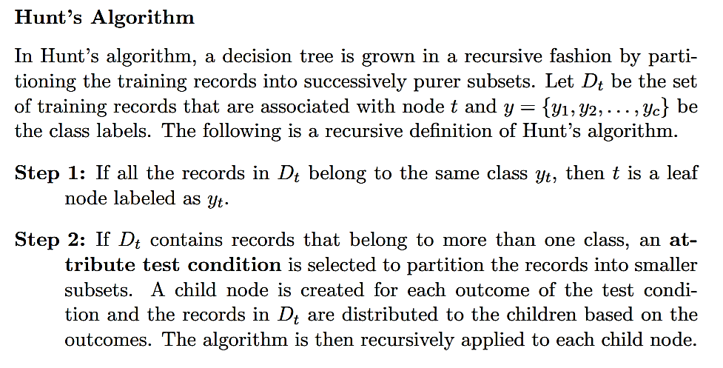
Decision Tree Algorithms

Slide 38
Decision Tree Algorithms…
Create a root node and assign all of the training data to it.
Select the best splitting attribute according to certain criteria.
Add a branch to the root node for each value of the split.
Split the data into mutually exclusive subsets along the lines of the specific split.
Repeat Steps 2 and 3 for each and every leaf node until the stopping criteria is reached.

Slide 39
Algorithms
C5, CART, and CHAID
1. Splitting criteria
  a. Which variable to use for the first split? How should one determine the most important variable for the first branch, and subsequently, for each subtree? There are many measures like least errors, information gain, and Gini coefficient.
  b. What values to use for the split? If the variables have continuous values, such as for age or BP, what value-ranges should be used to make bins?
  c. How many branches should be allowed for each node? There could be binary trees, with just two branches at each node. Or there could be more branches allowed.

Slide 40
Stopping criteria
When to stop building the tree?
There are two major ways to make that determination.
  depth of the branches has been reached to some value and the tree becomes unreadable after that.
  when the error level at any node is within predefined tolerable levels.

Slide 41
Pruning
The tree could be trimmed to make it more balanced and more easily usable.
The pruning is often done after the tree is constructed, to balance out the tree and improve usability.

Slide 42
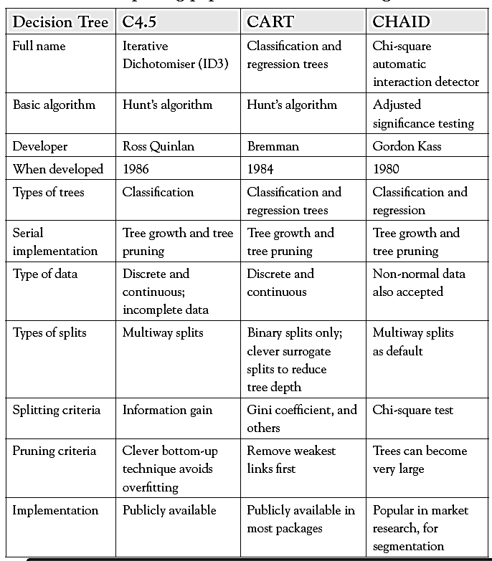
Comparison

Slide 43
Entropy
A formula to calculate the homogeneity of a sample
A completely homogeneous sample has entropy of 0
An equally divided sample has entropy of 1
Entropy(s) = - p+log2 (p+) -p-log2 (p-) for a sample of negative and positive elements
The formula for entropy is:
Entropy(S) = - (9/14) Log2 (9/14) - (5/14) Log2 (5/14)
= 0.940

Slide 44
Information Gain (IG)
The information gain is based on the decrease in entropy after a dataset is split on an attribute.
Which attribute creates the most homogeneous branches?
First the entropy of the total dataset is calculated.
The dataset is then split on the different attributes.
The entropy for each branch is calculated. Then it is added proportionally, to get total entropy for the split.
The resulting entropy is subtracted from the entropy before the split.
The result is the Information Gain, or decrease in entropy.
The attribute that yields the largest IG is chosen for the decision node.
A branch set with entropy of 0 is a leaf node.
Otherwise, the branch needs further splitting to classify its dataset.
The ID3 algorithm is run recursively on the non-leaf branches, until all data is classified.

Slide 45
Attribute Selection Measure: Information Gain (ID3/C4.5)
Select the attribute with the highest information gain
Let p_{i} be the probability that an arbitrary tuple in D belongs to class C_{i}, estimated by |C_{i, D}|/|D|
Expected information (entropy) needed to classify a tuple in D:
Information needed (after using A to split D into v partitions) to classify D:
Information gained by branching on attribute A
Notes:
I : the expected information needed to classify a given sample
E (entropy) : expected information based on the partitioning into subsets by A

Slide 46
What is ID3?
A mathematical algorithm for building the decision tree
Invented by J. Ross Quinlan in 1979
Uses Information Theory invented by Shannon in 1948
Builds the tree from the top down, with no backtracking
An attribute selection measure is a heuristic for selecting the splitting criteria that best separates a given data set into individual classes
Information Gain (IG) is used to select the most useful attribute for classification

Slide 47










Example
Person | Hair Length | Weight | Age | Class
ShivKumar | 0” | 250 | 36 | M
Pallavi | 10” | 150 | 34 | F
Chavan | 2” | 90 | 10 | M
Vasudha | 6” | 78 | 8 | F
Yamini | 4” | 20 | 1 | F
Murali | 1” | 170 | 70 | M
Pooja | 8” | 160 | 41 | F
Deepak | 10” | 180 | 38 | M
Ameer | 6” | 200 | 45 | M
X | 8” | 290 | 38 | ?

Slide 48
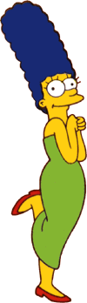




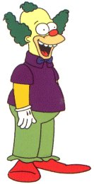



Entropy(4F,5M) = -(4/9)log₂(4/9) - (5/9)log₂(5/9)
= 0.9911
yes
no
Hair Length <= 5?
Let us try splitting on Hair length
Entropy(1F,3M) = -(1/4)log₂(1/4) - (3/4)log₂(3/4)
= 0.8113
Entropy(3F,2M) = -(3/5)log₂(3/5) - (2/5)log₂(2/5)
= 0.9710
Gain(Hair Length <= 5) = 0.9911 – (4/9 * 0.8113 + 5/9 * 0.9710 ) = 0.0911

Slide 49
Entropy(4F,5M) = -(4/9)log₂(4/9) - (5/9)log₂(5/9)
= 0.9911
yes
no
Weight <= 160?
Let us try splitting on Weight
Entropy(4F,1M) = -(4/5)log₂(4/5) - (1/5)log₂(1/5)
= 0.7219
Entropy(0F,4M) = -(0/4)log₂(0/4) - (4/4)log₂(4/4)
= 0
Gain(Weight <= 160) = 0.9911 – (5/9 * 0.7219 + 4/9 * 0 ) = 0.5900

Slide 50
Entropy(4F,5M) = -(4/9)log₂(4/9) - (5/9)log₂(5/9)
= 0.9911
yes
no
age <= 40?
Let us try splitting on Age
Entropy(3F,3M) = -(3/6)log₂(3/6) - (3/6)log₂(3/6)
= 1
Entropy(1F,2M) = -(1/3)log₂(1/3) - (2/3)log₂(2/3)
= 0.9183
Gain(Age <= 40) = 0.9911 – (6/9 * 1 + 3/9 * 0.9183 ) = 0.0183

Slide 51
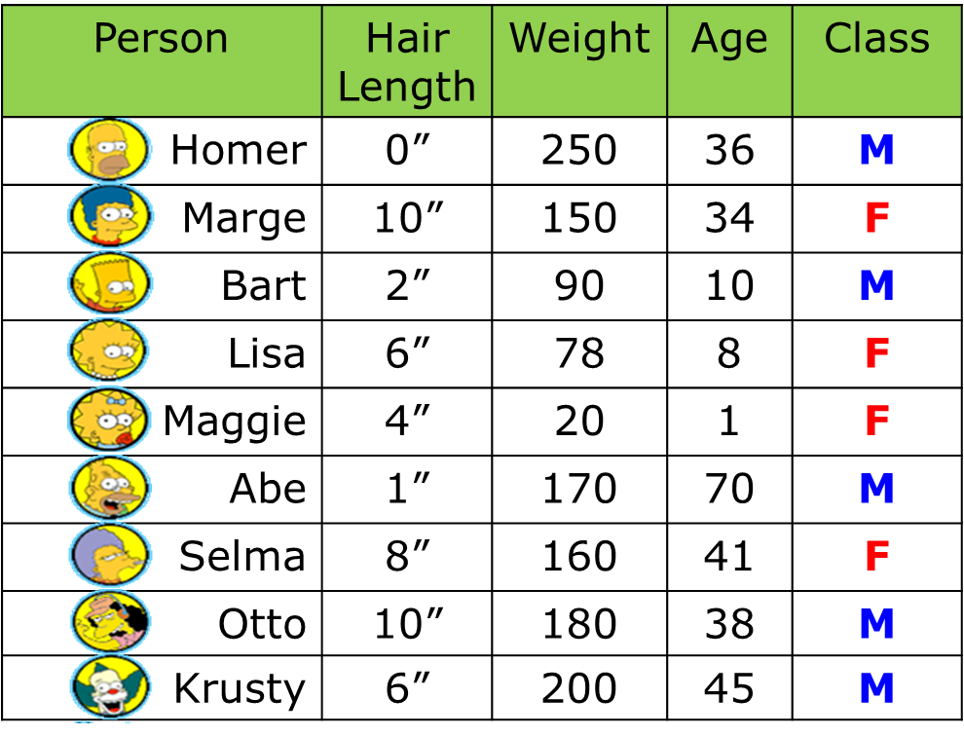
Of the 3 features we had, Weight was best, because of highest IG. But while people who weigh over 160 are perfectly classified (as males), the under 160 people are not perfectly classified… So we simply recurse!
yes
no
Weight <= 160?
This time we find that we can split on Hair length, and we are done!
yes
no
Hair Length <= 2?

Slide 52

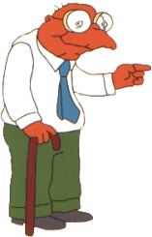


We don’t need to keep the data around, just the test conditions.
Weight <= 160?
yes
no
How would these people be classified?
Hair Length <= 2?
Male
yes
no
Male
Female

Slide 53
Weight <= 160?
It is trivial to convert Decision Trees to rules…
yes
no
Hair Length <= 2?
Male
yes
no
Male
Female
Rules to Classify Males/Females
If Weight greater than 160, classify as Male
Elseif Hair Length less than or equal to 2, classify as Male
Else classify as Female

Slide 55
Naïve-Bayesian Classification

Slide 56
Introduction
A statistical classifier: performs probabilistic prediction, i.e., predicts class membership probabilities
Foundation: Based on Bayes’ Theorem.
Performance: A simple Bayesian classifier, naïve Bayesian classifier, has comparable performance with decision tree and selected neural network classifiers
Incremental: Each training example can incrementally increase/decrease the probability that a hypothesis is correct — prior knowledge can be combined with observed data
Standard: Even when Bayesian methods are computationally intractable, they can provide a standard of optimal decision making against which other methods can be measured

Slide 57
Bayesian Theorem: Basics
Let X be a data sample (“evidence”): class label is unknown
Let H be a hypothesis that X belongs to class C
Classification is to determine P(H|X), the probability that the hypothesis holds given the observed data sample X
  Probability that X will buy a computer given his age and income
P(H) (prior probability), the initial probability
  E.g., X will buy computer, regardless of age, income, …
P(X): probability that sample data is observed
P(X|H) (posteriori probability), the probability of observing the sample X, given that the hypothesis holds
  E.g., Given that X will buy computer, the prob. that X is 31..40, medium income

Slide 58
Bayesian Theorem
Given training data X, posteriori probability of a hypothesis H, P(H|X), follows the Bayes theorem
Informally, this can be written as
  posteriori = likelihood × prior/evidence
Predicts X belongs to C₂ iff the probability P(C_{i}|X) is the highest among all the P(C_{k}|X) for all the k classes
Practical difficulty: require initial knowledge of many probabilities, significant computational cost

Slide 59
Towards Naïve Bayesian Classifier
Let D be a training set of tuples and their associated class labels, and each tuple is represented by an n-D attribute vector X = (x1, x2, …, xn)
Suppose there are m classes C1, C2, …, Cm.
Classification is to derive the maximum posteriori, i.e., the maximal P(Ci|X)
This can be derived from Bayes’ theorem
Since P(X) is constant for all classes, only
  needs to be maximized

Slide 60
Derivation of Naïve Bayes Classifier
A simplified assumption: attributes are conditionally independent (i.e., no dependence relation between attributes):
This greatly reduces the computation cost: Only counts the class distribution
If Ak is categorical, P(xk|Ci) is the # of tuples in Ci having value xk for Ak divided by |Ci, D| (# of tuples of Ci in D)
If Ak is continuous-valued, P(xk|Ci) is usually computed based on Gaussian distribution with a mean μ and standard deviation σ
  and P(xk|Ci) is

Slide 61
Example-1
age | income | student | credit_rating | buys_computer
<=30 | high | no | fair | no
<=30 | high | no | excellent | no
31…40 | high | no | fair | yes
>40 | medium | no | fair | yes
>40 | low | yes | fair | yes
>40 | low | yes | excellent | no
31…40 | low | yes | excellent | yes
<=30 | medium | no | fair | no
<=30 | low | yes | fair | yes
>40 | medium | yes | fair | yes
<=30 | medium | yes | excellent | yes
31…40 | medium | no | excellent | yes
31…40 | high | yes | fair | yes
>40 | medium | no | excellent | no
Class
  C1:buys_computer = ‘yes’
  C2:buys_computer = ‘no’
Data sample
  X = (age ≤ 30,
  income = medium,
  student = yes,
  credit_rating = fair)

Slide 62
Computation
 | Yes | No | Yes | No
P(Ci) | 9/14 | 5/14 | 0.643 | 0.357
P(X|Ci) |  |  | Prob. | Prob.
Age = youth | 2/9 | 3/5 | 0.222 | 0.6
Income = medium | 4/9 | 2/5 | 0.444 | 0.4
Student = yes | 6/9 | 1/5 | 0.667 | 0.2
Credit_rating = fair | 6/9 | 2/5 | 0.667 | 0.4
P(X|Ci) : P(X|buys_computer = “Yes”) = 0.222 x 0.444 x 0.667 x 0.667 P(X|buys_computer = “No”) = 0.6 x 0.4 x 0.2 x 0.4 |  |  | 0.044 | 0.019
P(X|Ci)*P(Ci) for “Yes” = 0.044*0.643 P(X|Ci)*P(Ci) for “No” = 0.019*0.357 |  |  | 0.028 | 0.019
So, X is classified as “YES”

Slide 63
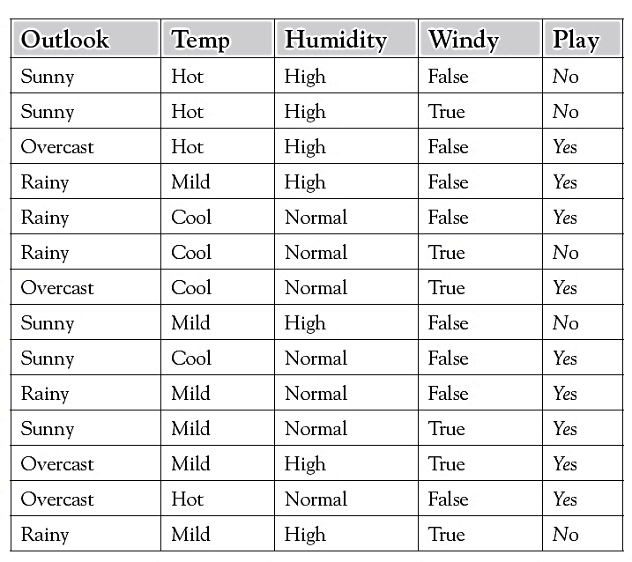
Exercise
 | Yes | No | Yes | No
P(Ci) | 9/14 | 5/14 | 0.643 | 0.357
P(X|Ci)
Outlook | 2/9 | 3/5 |  | .6
Temp | 2/9 | 2/5 |  | .4
Humidity | 6/9 | 1/5 |  | .2
Windy | 3/9 | 3/5 |  | .6
P(X|Ci) :
P(X|Ci)*P(Ci) for “Yes” P(X|Ci)*P(Ci) for “No” |  |  | 0.00705 | 0.01028
So, X is classified as “No”

Slide 64
Example – 2 : Text Classification
Data Set | Doc. ID | Keywords | Class = h (Healthy)
Training Data | 1 | Love Happy Joy Joy Love | Yes
 | 2 | Happy Love Kick Joy Happy | Yes
 | 3 | Love Move Joy Good | Yes
 | 4 | Love Happy Joy Pain Love | Yes
 | 5 | Joy Love Pain Kick Pain | No
 | 6 | Pain Pain Love Kick | No
Test Data | 7 | Love Pain Joy Love Kick | ?
Doc ID | Love | Happy | Joy | Kick | Pain | Good | Move | Class
1 | 2 | 1 | 2 | 0 | 0 | 0 | 0 | Yes
2 | 1 | 2 | 1 | 1 | 0 | 0 | 0 | Yes
3 | 1 | 0 | 1 | 0 | 0 | 1 | 1 | Yes
4 | 2 | 1 | 1 | 0 | 1 | 0 | 0 | Yes
5 | 1 | 0 | 1 | 1 | 2 | 0 | 0 | No
6 | 1 | 0 | 0 | 1 | 2 | 0 | 0 | No
Yes | 6 | 4 | 5 | 1 | 1 | 1 | 1 | 19
No | 2 | 0 | 1 | 2 | 4 | 0 | 0 | 9

Slide 65
Solution
 | Yes | No | Yes | No
P(Ci) | 4/6 | 2/6 | 0.666 | 0.333
P(X|Ci) |  |  | Prob. | Prob.
Love | 6/19 | 2/9 | 0.315 | 0.222
Pain | 1/19 | 4/9 | 0.052 | 0.444
Joy | 5/19 | 1/9 | 0.263 | 0.111
Love | 6/19 | 2/9 | 0.315 | 0.222
Kick | 1/19 | 2/9 | 0.052 | 0.222
P(X|Ci) : P(X|Healthy = “Yes”) P(X|Healthy = “No”) |  |  | 0.0000705 | 0.0005392
P(X|Ci)*P(Ci) for “Yes” = 0.044*0.643 P(X|Ci)*P(Ci) for “No” = 0.019*0.357 |  |  | 0.00004699 | 0.0001795
So, Doc. 7 is classified as “NO”

Slide 66

Example 2 (Continuous Data)
Normal distribution:
  One for each (A_{i},c_{i}) pair
For (Income, Class=No):
  If Class=No
    sample mean = 110
    sample variance = 2975
This is the formula for Standard Deviation:

Slide 67
Advantages & Disadvantages
It is Simple.
Conditional probabilities can be computed for discrete data and for probabilistic distributions.
NB assumes all features are independent. But this may be a limitation.
Even if the probability of one of the features is ZERO, then the entire computation leads to zero.
NB is not good for event happenings.

Slide 68
Support Vector Machine (SVM)

Slide 69
Left as an Exercise / Assignment

Slide 70
The k-Nearest Neighbor Classification
Eager learners - learn early
  Decision tree and rule based
Lazy learners - delay the learning until it is required
  Root classifiers and KNN
KNN
  Find all the training samples that are similar to the test sample
  "If it walks like a duck, quack like duck, and looks like a like a duck....?
A nearest neighbor classifier represents each sample as a data point in d-dimensional space

Slide 71
Nearest Neighbor Classifiers
Compute Distance
Test Record
Training Records
Choose k of the “nearest” records

Slide 72
Definition of Nearest Neighbor
K-nearest neighbors of a record x are data points that have the k
smallest distance to x. Fig (c) x is classified as +. Fig (b) it is classified as -.

Slide 73
Nearest-Neighbor Classifiers
Requires three things
  The set of stored records
  Distance Metric to compute distance between records
  The value of k, the number of nearest neighbors to retrieve
To classify an unknown record:
  Compute distance to other training records
  Identify k nearest neighbors
  Use class labels of nearest neighbors to determine the class label of unknown record (e.g., by taking majority vote)

Slide 74
The k-Nearest Neighbor - Example
k-nearest neighbor is a supervised learning algorithm where the result of new instance query is classified based on majority of k-nearest neighbor category.
The purpose of this algorithm is to classify a new object based on attributes and training samples
Now the factory produces a new paper tissue that pass laboratory test with X1 = 3 and X2 = 7. Without another expensive survey, can we guess what the classification of this new tissue is?
X1 = Acid Durability (seconds) | X2 = Strength (kg/square meter) | Classification
7 | 7 | Bad
7 | 4 | Bad
3 | 4 | Good
1 | 4 | Good

Slide 75
Major Steps
Determine parameter k = number of nearest neighbors
Calculate the distance between the query-instance and all the training samples
Sort the distance and determine nearest neighbors based on the k-th minimum distance
Gather the category of the nearest neighbors
Use simple majority of the category of nearest neighbors as the prediction value of the query instance
Ref:
http://people.revoledu.com/kardi/tutorial/KNN/KNN_Numerical-example.html

Slide 76
Example
X1 = Acid Durability (seconds) | X2 = Strength (kg/square meter) | Square Distance to query instance (3, 7)
7 | 7 | (7-3)² + (7-7)² = 16
7 | 4 | (7-3)² + (4-7)² = 25
3 | 4 | (3-3)² + (4-7)² = 9
1 | 4 | (1-3)² + (4-7)² = 13
X1 | X2 | Sq Dist | Rank | Included?
7 | 7 | 16 | 3 | Yes
7 | 4 | 25 | 4 | No
3 | 4 | 9 | 1 | Yes
1 | 4 | 13 | 2 | yes
X1 | X2 | Sq Dist | Rank | Included? | Y=category
7 | 7 | 16 | 3 | Yes | Bad
7 | 4 | 25 | 4 | No | -
3 | 4 | 9 | 1 | Yes | Good
1 | 4 | 13 | 2 | yes | Good
Result: the new tuple belongs to “Good”, because of majority (2)

Slide 77
PySpark & ML Library
Will be discussed during Lab Session

Slide 78
Thank You

